Slide 1
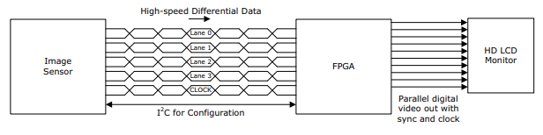
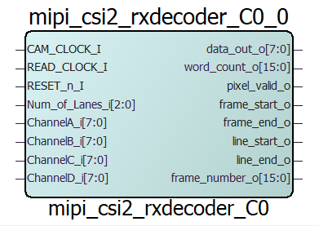
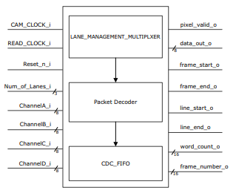
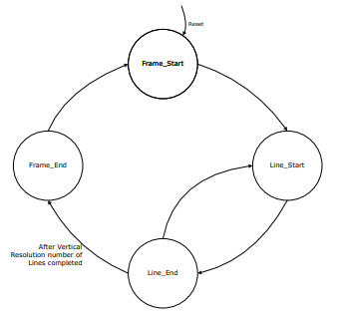
MIPI CSI-2 Receiver Decoder
Microsemi supports only RAW8 data type
MIPI | Image Sensor
CAM_CLOCK_I
READ_CLOCK_I | VSYNC (start)
RESET_n_I | VSYNC (end)
Number_of_lanes
ChannelA
ChannelB
ChannelC
ChannelD
data_out_o
word_count_o
pixel_valid_o
frame_start_o
frame_end_o
line_start_o
line_end_o
frame_number_o

